Slide 1
GCSE Art & Design
AQA GCSE Art and Design
AQA | Subjects | Art and Design | GCSE
Why choose GCSE Art and Design?
If you enjoy being creative, want to increase your practical skills and improve your analytical, communication and research abilities, art and design is a great choice.
The skills you gain make it a great complement to other subjects.
Art and design is a way of seeing things and making sense of the world around you. It can help you with further study and prepare you for the world of work.
ENJOY, COMPETE, ACHIEVE

Slide 2
Exam Board, Course Structure, Assessment
AQA GCSE Art and Design
60% Coursework 40% Exam
Practical work supported by written work
1st Year | 2nd Year
Coursework Preparation Skill building Experimenting Developing Refining | Coursework Completion Exam Project - with teacher support 10-hour exam (split over two days)
ENJOY, COMPETE, ACHIEVE

Slide 3
GCSE Art and Design Course Structure
What will you study?
Art, craft and design
This course is an excellent general introduction to the study of art, craft and design. You’ll look at different approaches to art and use lots of different media, techniques and materials.
At Desborough College we study the following areas;
Fine Art | Graphic Communication |Three-dimensional design | Photography
The course is structured using four Assessment Objectives
AO1: Developing ideas
AO2: Refining work
AO3: Recording ideas, observations and insights
AO4: Presenting a personal and meaningful response demonstrating understanding of visual language.
ENJOY, COMPETE, ACHIEVE

Slide 4
Course Structure and Assessment
How will you be assessed?
60% Coursework 40% Exam
Component 1 Portfolio: produce a sustained project and a selection of further work that represents the course of study. This is worth 60% of your overall marks.
Component 2 Externally set assignment: there’s a separate externally set task paper for each title. It features seven tasks, and you have to complete one of them. You get preparation time, plus ten hours of supervised time (the exam). This is worth 40% of your total marks.
ENJOY, COMPETE, ACHIEVE

Slide 5
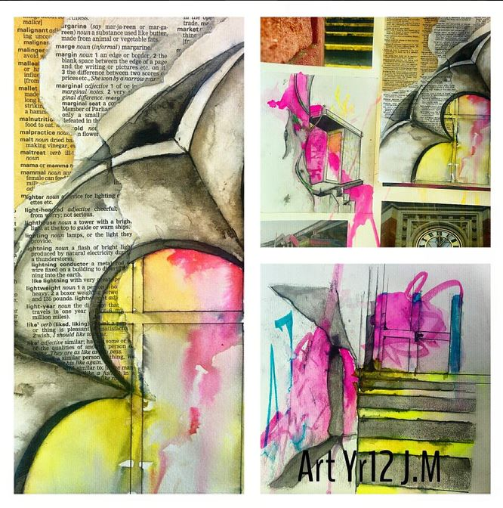
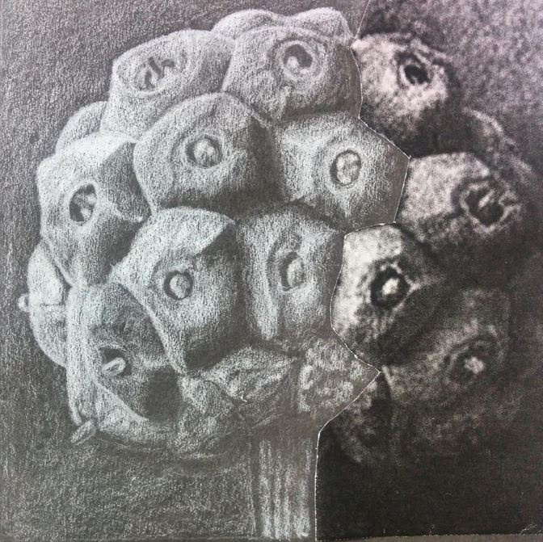
Key Skills
What skills will you learn?
Alongside improving your practical expertise, you’ll learn how to:
develop, refine and record your ideas.
present a personal response that realises your intentions.
improve your creative skills through the effective and safe use of media, materials, techniques, processes and technologies.
successfully use visual language and the formal elements to communicate your ideas.
use drawing skills for different needs and purposes.
ENJOY, COMPETE, ACHIEVE

Slide 6
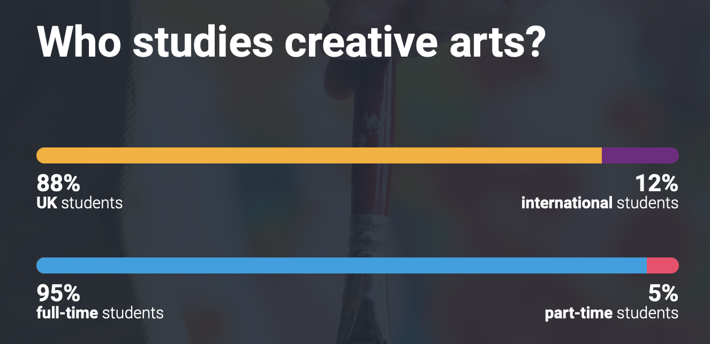
Post-18 Education
Source: UCAS website
You can continue your art and design studies at AS and A-level, whether at school or in Sixth Form college.
Studying art and design helps to create a broad and balanced curriculum, which is an excellent foundation for whatever you want to do afterwards. The transferable skills you’ll gain, such as creativity, analysis and problem solving, complement a range of other subjects and careers.
Employers and universities regard all of these skills highly.
From creating expressive artwork to implementing industry-changing designs, Art & Design graduates have the chance to leave their mark on the world. There are currently over 178 universities offering 1426 courses including art and design in the U.K.
ENJOY, COMPETE, ACHIEVE

Slide 7
Careers
Art and design opens the door to lots of exciting careers.
Try these for starters:
New technologies are creating a whole new range of courses where art is being used in innovative ways.
Animator | Visual Media | Photographer | Product Design
Video game designer | Graphic design | Museum curator | Ceramics
Illustrator | Theatre designer | Architecture | Advertising
Publishing | Interior Design | Retail Design | Exhibition design
Artist | Fashion Design | Jewellery Design | Surface Pattern Design
ENJOY, COMPETE, ACHIEVE

Slide 8
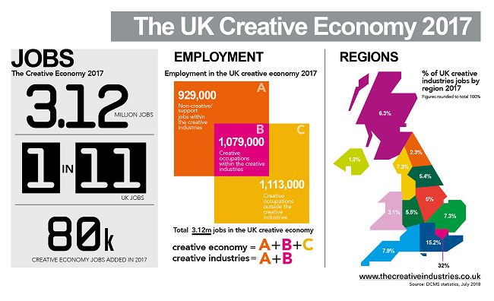
Where will GCSE Art and Design take you?
ENJOY, COMPETE, ACHIEVE

Slide 9
Where will GCSE Art and Design take you?
ENJOY, COMPETE, ACHIEVE

Slide 10
A GCSE ART Student
Passionate about Art!
Risk-Taking – you enjoy experimenting, exploring new materials and methods.
Thoughtful – you can reflect on your work and appreciate the process.
Analyses their own work and that of other artists.
Inspired – you look for inspiration everywhere and often have creative ideas.
Interested in art – you enjoy visiting galleries, looking to professional artists for inspiration and learning about art history.
A global citizen who is open to learning about other cultures.
Independent – you are responsible and happy to continue working outside of the classroom on your projects.
A lifelong-learner – you know that there is always more to learn and you are always growing.

