Slide 1
BUSINESS STUDIES GCSE
BUSINESS IN THE REAL WORLD
Notes:
Why should I be interested in Business Studies?

Slide 2
Have you ever wondered…
Why some people prefer X-Box and some people prefer PlayStation?

Slide 3
Have you ever wondered…
Why Red Bull gives you wings or Meerkats should sell insurance?

Slide 4
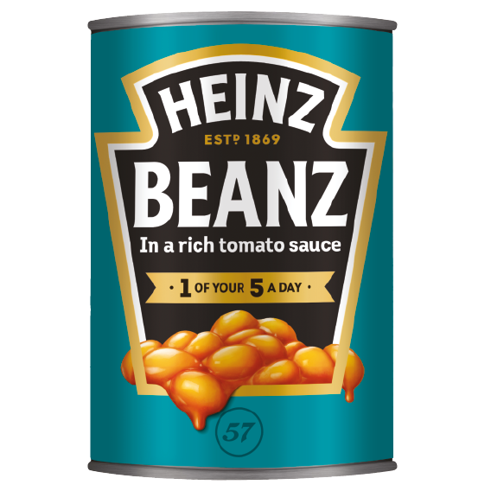
Have you ever wondered…
How Heinz make 4 ½ MILLION cans of Baked Beans every day, or how a £2.8 BILLION superyacht is made?

Slide 5
Have you ever wondered…
How Tesla can be valued at $515 Billion, but doesn’t make a profit?!

Slide 6
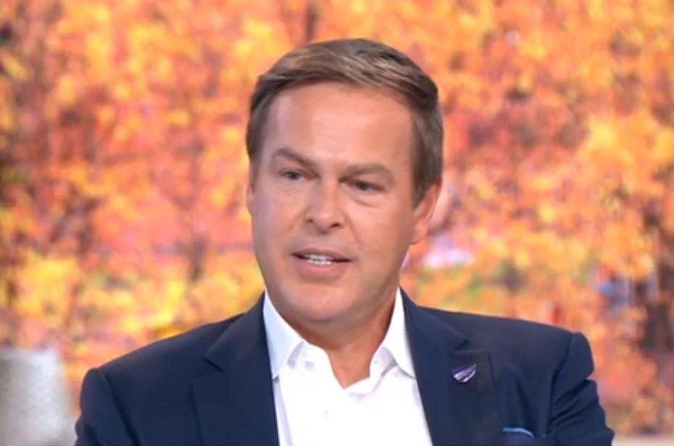
DID YOU KNOW…
Peter Jones, star of Dragons’ Den, whose net worth is c. $400 million, went to Desborough?

Slide 7
What will I learn about?
Business in the Real World
Why people start businesses; Business ownership; Business Plans; Location; Stakeholders; Growth
Influences on Business
Legislation; Technology; Globalisation; Ethics & the Environment; Economic Climate
Operations
Production Processes; Procurement; Quality; Customer Service
Human Resources
Organisational Structure; Recruitment; Motivation; Training
Marketing
Understanding Customers; Segmentation; Market Research; Marketing Mix
Finance
Sources of finance; Cash flow; Financial Terms & Calculations; Analysing Financial Performance

Slide 8
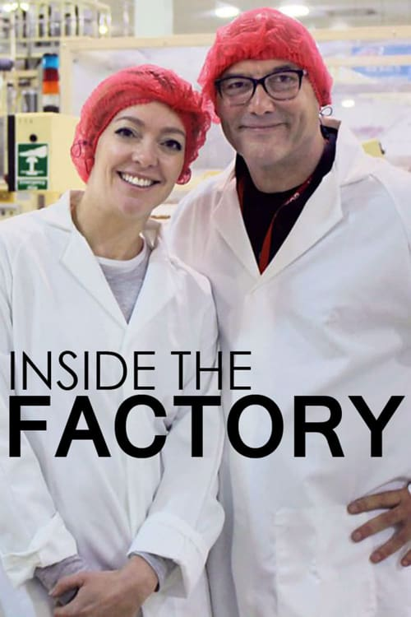
How will I learn?
As well as classroom lessons and online resources like Seneca Learning…..

Slide 9
How will I be assessed?
2 exams at the end of year 11
1 focused on Operations and Human Resources, 1 hour 45 minutes
1 focused on Marketing and Finance, 1 hour 45 minutes

Slide 10
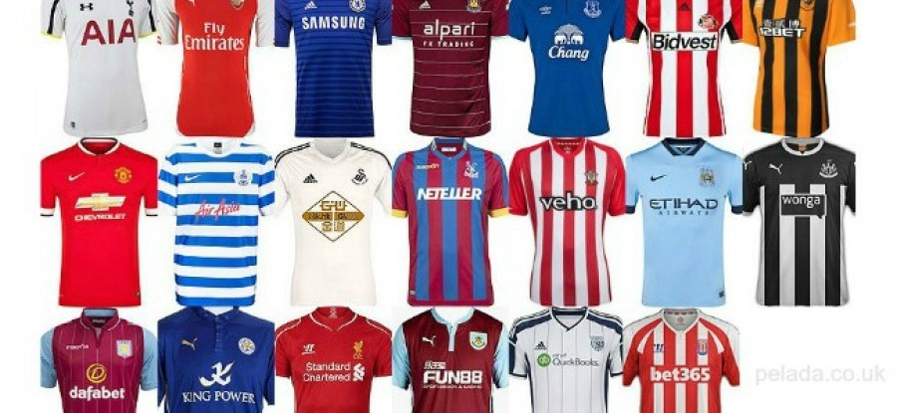
How will it help me?
Academically, it will help you towards Business Studies A-Level or BTEC in 6th Form and maybe even a Business Degree at University, but also….
Business Studies is about real life! How things are made, why Lidl is cheaper than Waitrose, why businesses sponsor football clubs, why great customer service helps a business succeed and why bad customer service can ruin things, what motivates people, how technology is changing the world and how important it is for people and companies to behave ethically and consider their impact on the environment. It should also help with getting a job, budgeting, planning, or even starting your own business!

Slide 11
How can I find out more?
Online for specification: https://www.aqa.org.uk/subjects/business/gcse/business-8132/specification-at-a-glance
Or contact Mr Andrews-Jones garethandrews-jones@desborough-college.net
We look forward to welcoming you to Business Studies in Year 10!

