Slide 1
computer science
Learn about how computers work

Slide 2
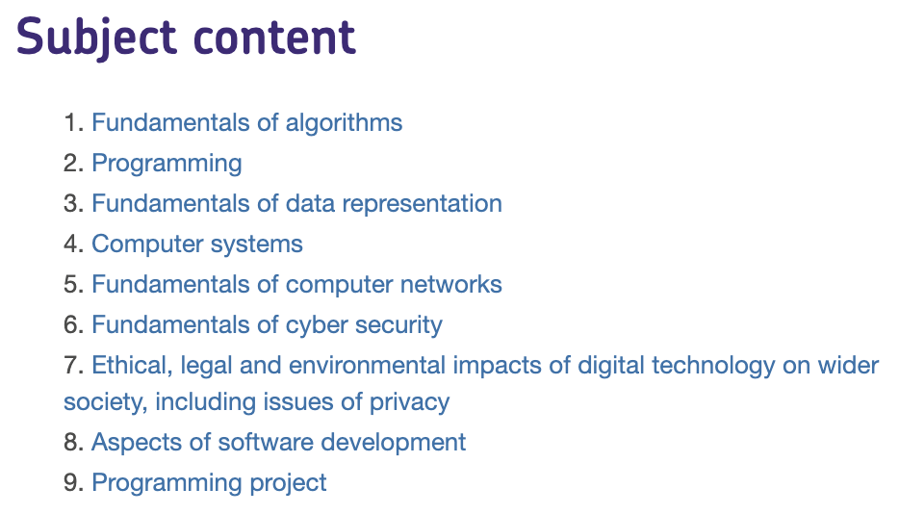
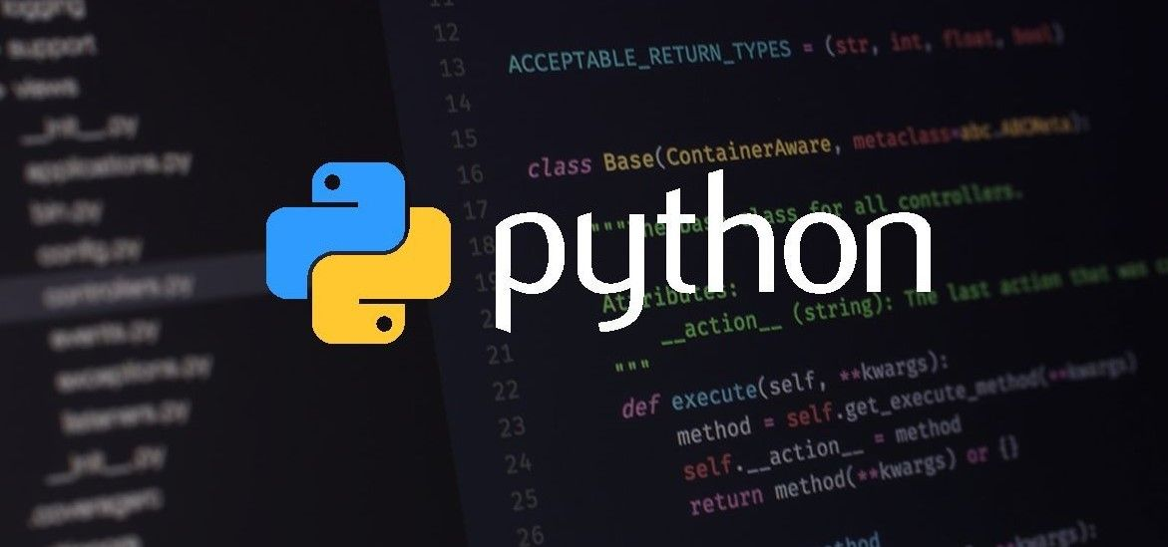
computer science
If you like learning about how computers work, if you enjoy or are desperate to learn programming or if you want to learn about networking and security, then Computer science is the course for you. This course has a number of modules:
You’ll be learning Python in depth
This course has 1 exam in year 11.

Slide 3
computer science
Problem solving is core to computer science. During the the two years, you’ll be applying what you’ve learned to solve a wide variety of problems. Our current Year 10s are working on programming virtual racing cars to follow a track and to win races. See roboton.io if you’d like a preview.
Later in the year, they’ll be making their own networks and understanding exactly how computers work.

Slide 4
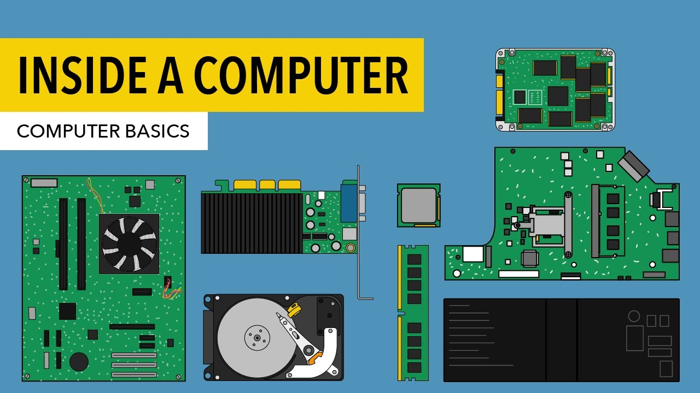
This is a great course
You’ll enjoy this course if:
you want to learn, or are already learning a programming language and are enjoying this
you are keen to build your own computer
you like problem solving, and find that you’re good at problem solving in maths
Although it’s not completely needed, a good understanding
of maths is beneficial.

