Slide 1
GCSE GEOGRAPHY at desborough College

Slide 2
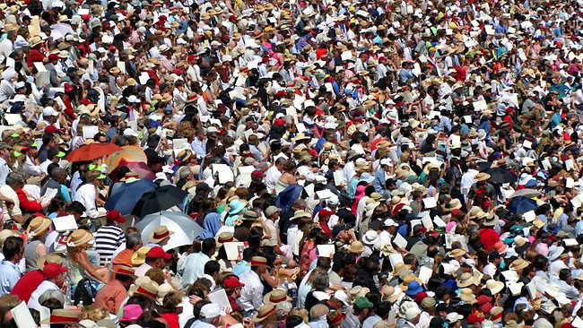
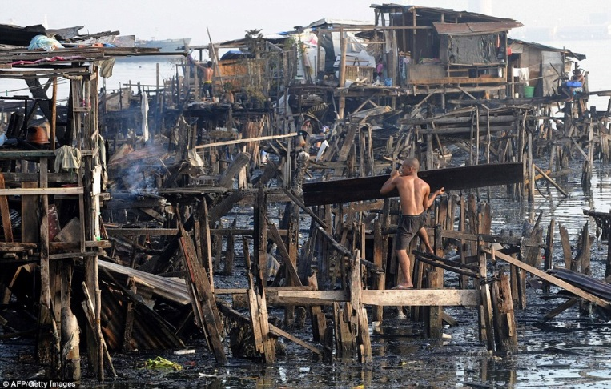
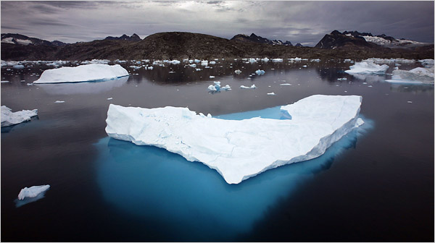
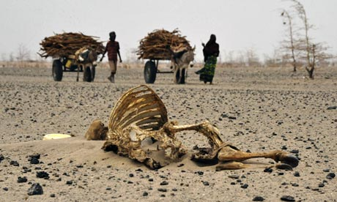
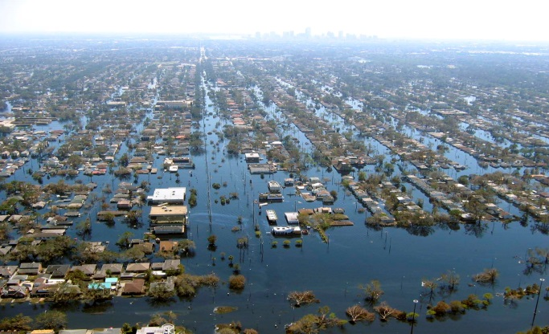

Slide 3
"Geography is the subject which holds the key to our future"
Michael Palin
Geography is the study of the world
It’s your world – know it!

Slide 4
Why do Geography?
It’s interesting - it’s the subject most people wished they studied at school - Newspaper
It gives you skills - It brings together lots of skills from different subjects including Science (processes), History (background), Sociology (People), Politics (decisions) and economics (£)
It’s Useful
For University (Russell Group ‘facilitating subjects’) and in the EBacc.
For Jobs (environmental science, green issues, tackling global warming, politics, urban planning, journalism, NGOs, politics, economists etc.) Volcanologists!

Slide 5
Why do Geography?

Slide 6
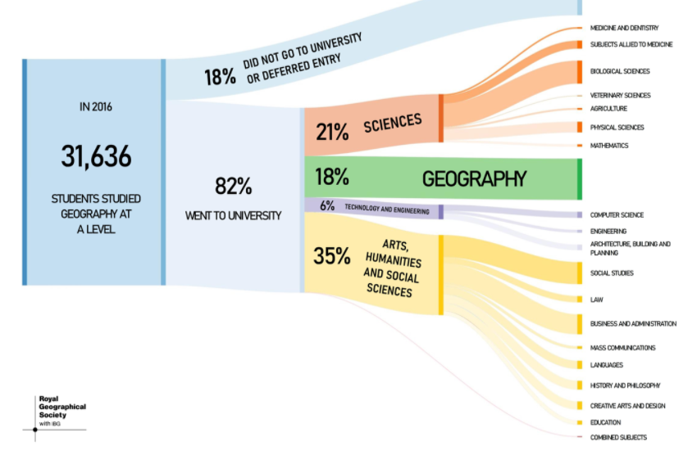
Destination of GCSE geographers

Slide 7
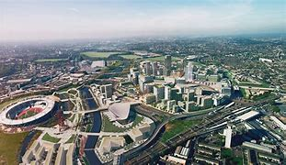
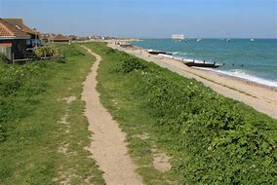
Trips x2
Stratford in East London to assess how quality of life can vary in an urban area.
Selsea Bill in Sussex to assess the need for coastal management.

Slide 8
What will we teach?
Paper – Global Geographical Issues
Section 1 – Hazardous Earth | Section 2 – Development Issues | Section 3 – Challenges of an urbanising world
Climate change and atmospheric processes Atmospheric circulation Ocean currents Global circulation Climate change – Evidence Climate change – Natural causes Climate change – Human causes Consequences of climate change Geographical skills Geographical skills 2 What are cyclones How cyclones form Bangladesh Case Study Aila USA Case study Bangladesh Vs USA Analysis Half Way Assessment Tectonics Earth’s structure Cores internal heat Plate boundaries Types of volcano Earthquakes – What & Predict Earthquake – Japan Earthquake – Haiti Tsunami – What are they? Boxing Day Tsunami 2004 Assessment | Global inequality What is development? Measuring Development Population Pyramids Global inequality Malawi case study Theories Globalisation Globalisation – Clarke fisher model Mid-Point Assessment India – Managing to develop Introduction to India Indian economic trends TNC’s in India (PC Lesson) Impacts of economic growth Top-down/ Bottom-up development India’s geopolitical influence Revision Techniques Assessment | Challenges of rapid urbanisation World becoming urbanised Patterns of megacities Urban process and change Urban economies Urban population Change – NYC case study Urban Land use Mumbai Case study Mumbai Introduction Mumbai’s population growth Mumbai’s opportunities Challenges facing Mumbai Mumbai Quality of Life Sustainable Mumbai - 1 Sustainable Mumbai – 2 Revision techniques Assessment

Slide 9
What will we teach?
Paper – UK Geographical Issues
Section 4 – The UK’s evolving physical landscape | Section 5 – The UK’s evolving human landscape | Section 6 – Geographical investigations
The UK’s evolving physical landscape Landscapes from the past UK’s rock type Physical processes Human landscape Coastal Change and conflict Types of Waves Coastal Erosion Headlands & Bays Erosional Features Coastal Transport Depositional Landforms Weathering and Mass Movement Midway Assessment Human activities Christchurch Bay Coastal Flooding Managing the Coast 1 Managing the Coast 2 Geographical Skills Revision techniques Coasts Assessment River Processes and Pressure Drainage Basin Methods of erosion Transportation & Deposition River Profiles The Upper Course The Middle Course The Lower Course Geographical Skills Hydrographs Sheffield Case Study Future threats River Management Revision techniques River Assessment | Urban & Rural Who lives where UK Population UK Economic Change Globalisation Significance of London London Land Use London Migration Docklands Development Stratford Olympic Park Stratford Olympic Park 2 London Sustainability Urban Rural Dependence Rural Challenges Rural Diversification Revision techniques Urban Assessment | Coastal fieldwork – Selsey Introduction to Investigation Data Collection – Beach profiles Data Collection - Sediment Analysis Data Collection - Sediment Analysis 2 Data Collection - Qualitative Secondary Data Sources Writing up Investigation 1 Writing up Investigation 2 Writing up Investigation 3 Writing up Investigation 4 Writing up Investigation 4 Writing up Investigation 5 Writing up Investigation 6 Urban Fieldwork – Stratford Introduction to Stratford Fieldwork Methods Is Regeneration good? Fieldwork Preparation Presenting Data Data fill Mapping and Methodology Fieldwork Analysis Analysis and Conclusions

Slide 10
What will we teach?
Paper – People and Environment Issues
Section 7 – People and Environment Issues | Section 8 – Forests Under Threat | Section 9 – Consuming Energy Resources
Global Distribution of Biomes Local factors Clime graphs A life support system Biomes and a global service Population versus resources Revision techniques Assessment | Structure, functioning and adaptations of the TRF Rainforests and Biodiversity Plants and animals adapted to living in the Taiga Threatened tropical rainforests Tropical rainforests and climate change Taiga threatened by commercial development What is reducing biodiversity in the Taiga Global actions protecting the rainforest Managing TRF sustainably Managing Taiga sustainably Revision techniques Assessment | Energy resource classification Patterns of energy use Environmental impacts Oil 1 Oil 2 Economic benefits and costs Tar sands & shale gas Energy efficiency Costs and benefits 1 Costs and benefits 2 Different views towards energy futures Attitudes towards renewable energy Revision techniques Assessment
Section 10 – Making a Geographical decision
6 Lessons on Synoptic skills and how to use different resources.

Slide 11
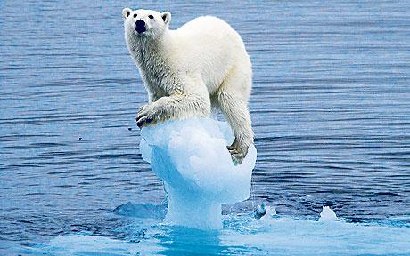
Hazards and Climate Change

Slide 12
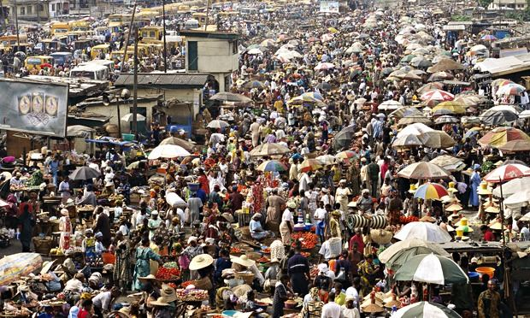
Development and Population

Slide 13
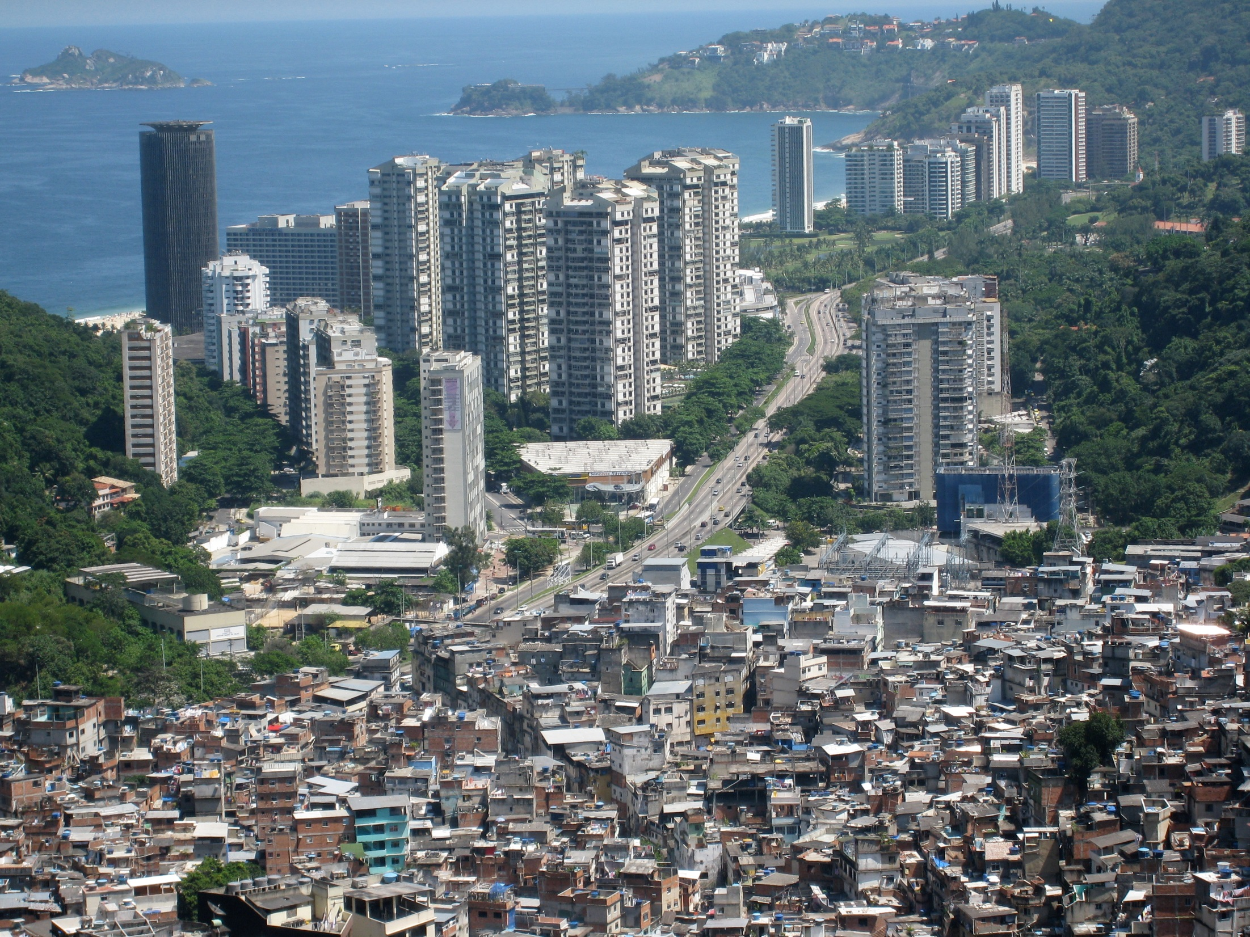
Urban growth and Megacities

Slide 14
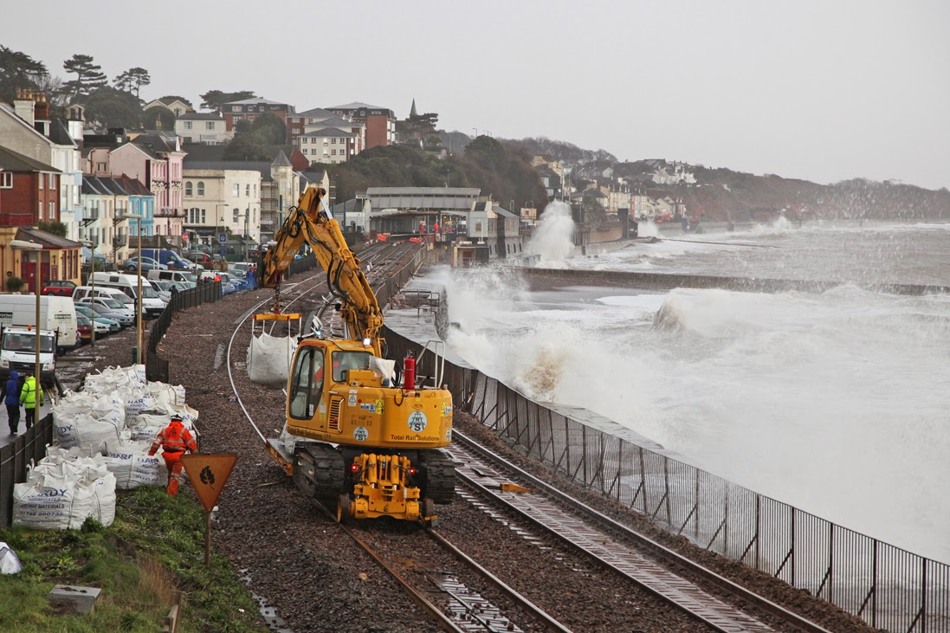
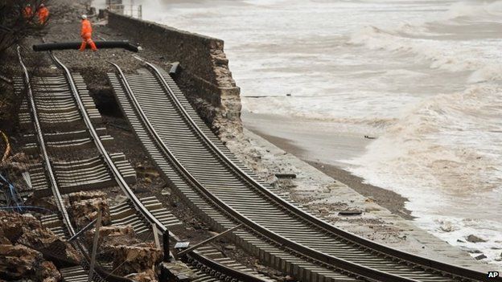
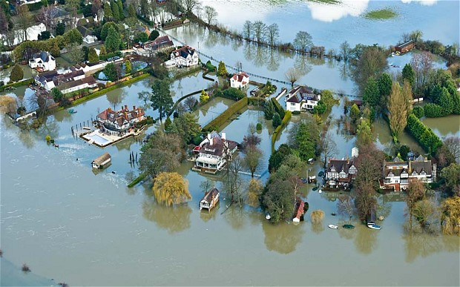
UK Coast and Rivers

Slide 15
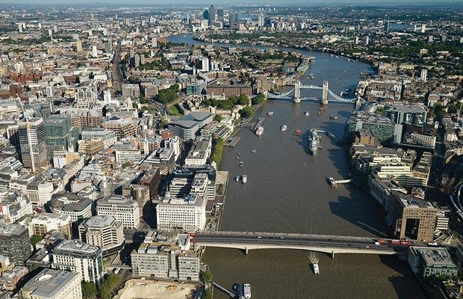
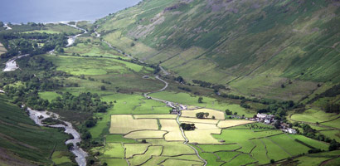
UK Cities and Countryside

Slide 16
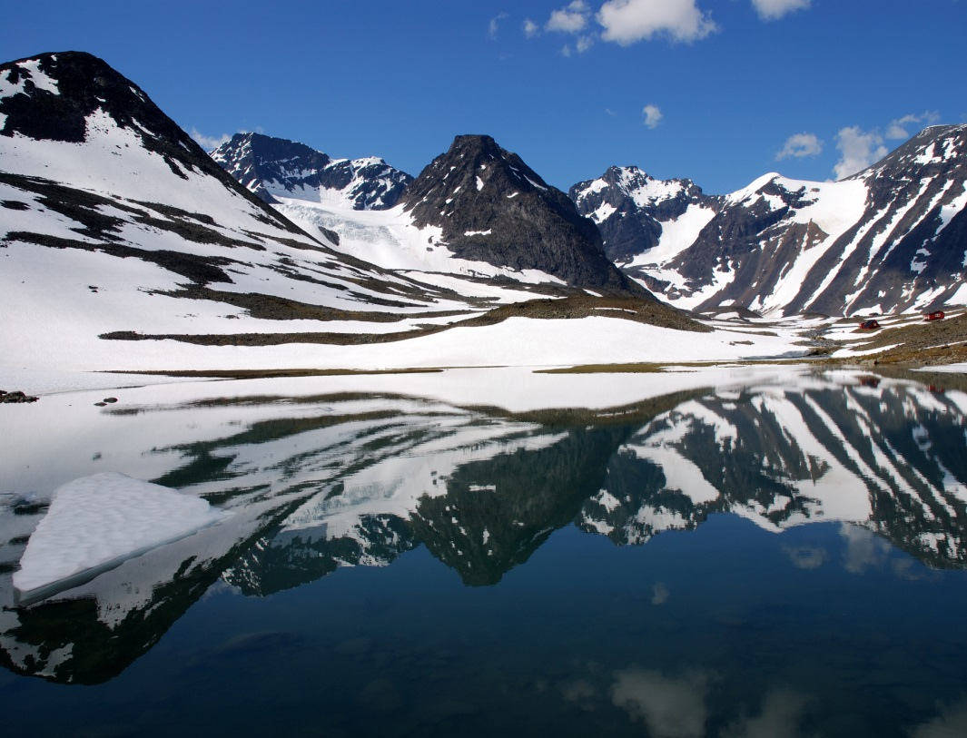
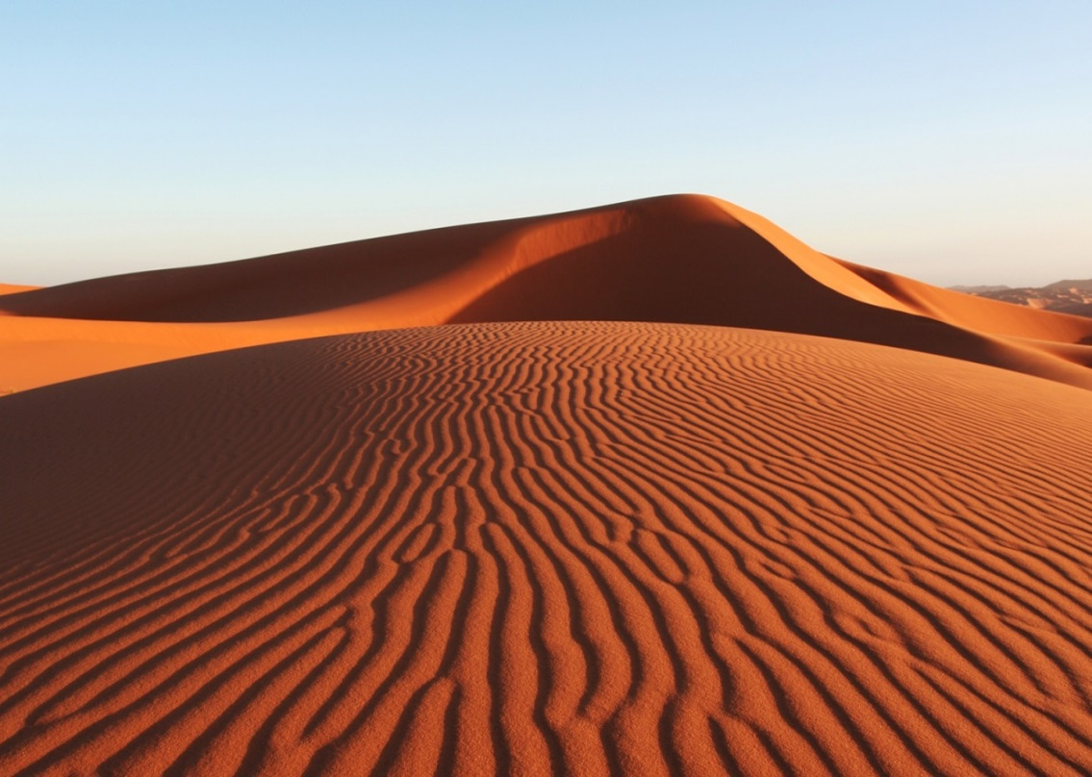
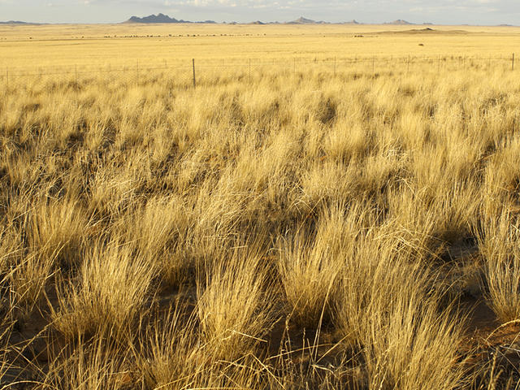
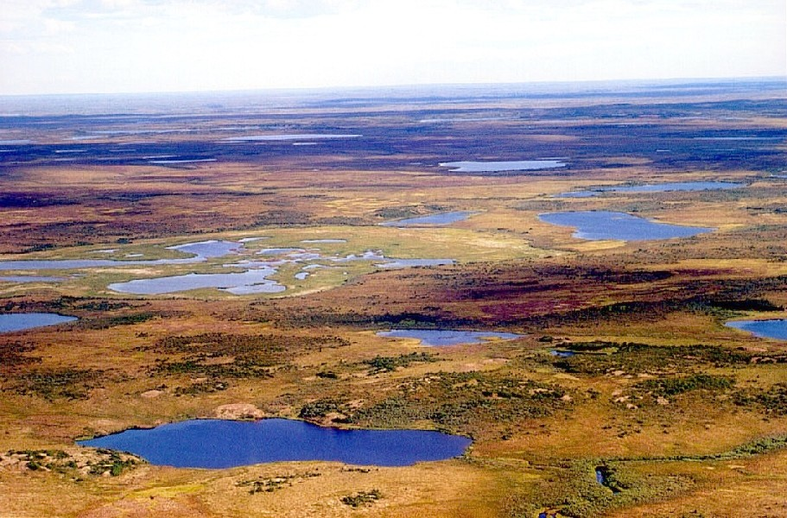
Ecosystems

Slide 17
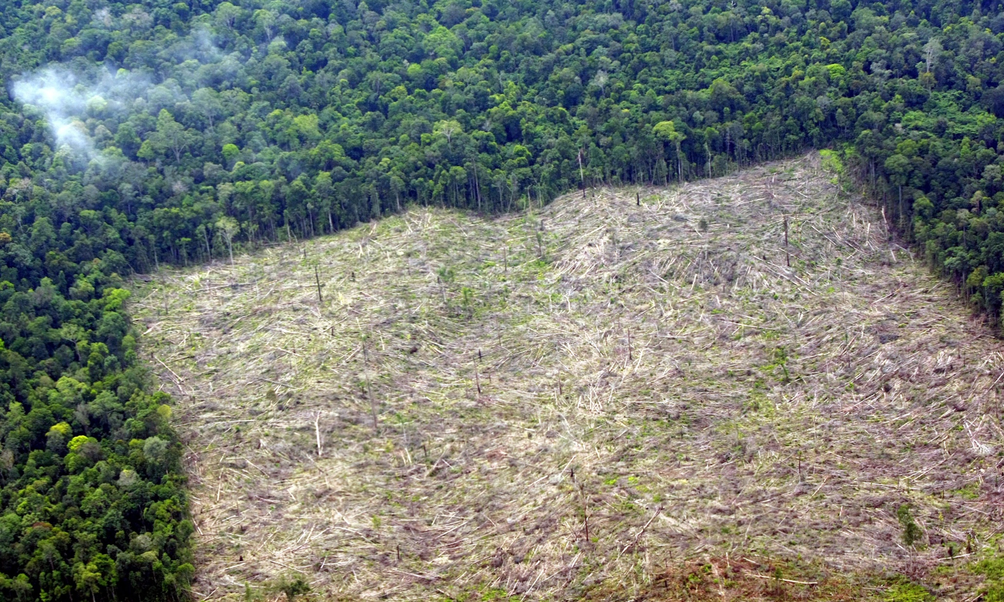
Rainforests

Slide 18
Energy

Slide 19
How is it Assessed?
GCSE Geography is assessed in 3 ways
Global Geography Exam (90 minutes)
UK Geography Exam (90 minutes)
Environmental Geography Exam (90 minutes)

Slide 20
Website
The Desborough College website has a full list of what we teach at GCSE
Geography - Desborough College
For more information about what is in the Geography GCSE and how it will be assessed visit the Edexcel GCSE Geography website http://qualifications.pearson.com/en/qualifications/edexcel-gcses/geography-b-2016.html

Slide 21
A letter from Michael Palin explaining how important geography is in a young persons education
Geography is not only up-to-date and relevant, it is one of the most exciting, adventurous and valuable subjects to study today. So many of the world's current problems boil down to geography, and need the geographers of the future to help us understand them. Global warming, sustainable food production, natural disasters such as earthquakes and tsunamis, the spread of disease, the reasons for migration and the future of energy resources are just some of the great challenges facing the next generation of geographers. A knowledge of geography, instilled into me by two excellent teachers, has enriched my life and encouraged me to take on long and sometimes difficult journeys. Geography has stimulated my mind and given me the attitude to go out and see for myself, rather than be told by others. Choosing geography at school can open the doors to a university degree, either specifically in geography or by combining geography with other A Levels to gain a place on a degree programme in another subject. An A Level in geography is recognised for its academic ‘robustness’ and, most importantly, it also helps young people into the world of work. We know this is true because so many employers prize the knowledge and skills that studying geography can provide, be it knowing how the world works, planning research and report writing, working in a team, using new technologies and communication skills – and much more. You will find geographers working in a wide range of jobs, from the City to planning, working in the environment to travel and tourism, or in international charities or retail. As you can see overleaf, studying geography can help young people achieve careers that are professionally and financially rewarding and also enjoyable. Last year I was delighted to hear that more than 230,000 pupils studied a GCSE or A Level in geography. So, alongside the other subjects that your son or daughter might study, I would encourage them to choose a GCSE or A Level in geography. It meant a lot to me and it could mean a lot to them. With best wishes Michael Palin, CBE

