Slide 1
Health and fitness

Slide 2
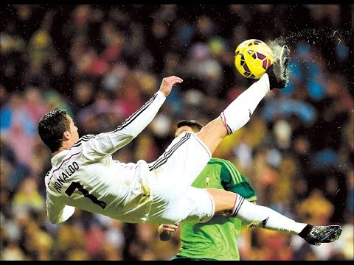
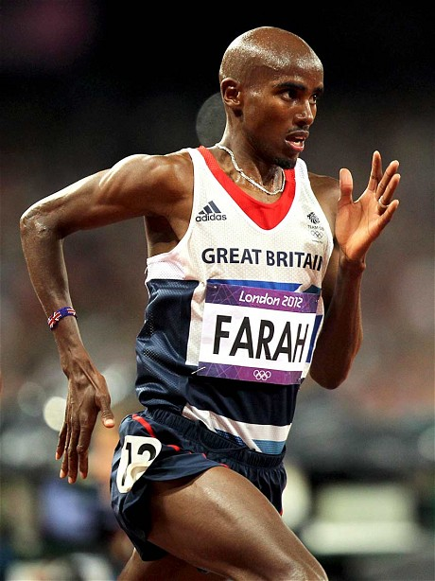
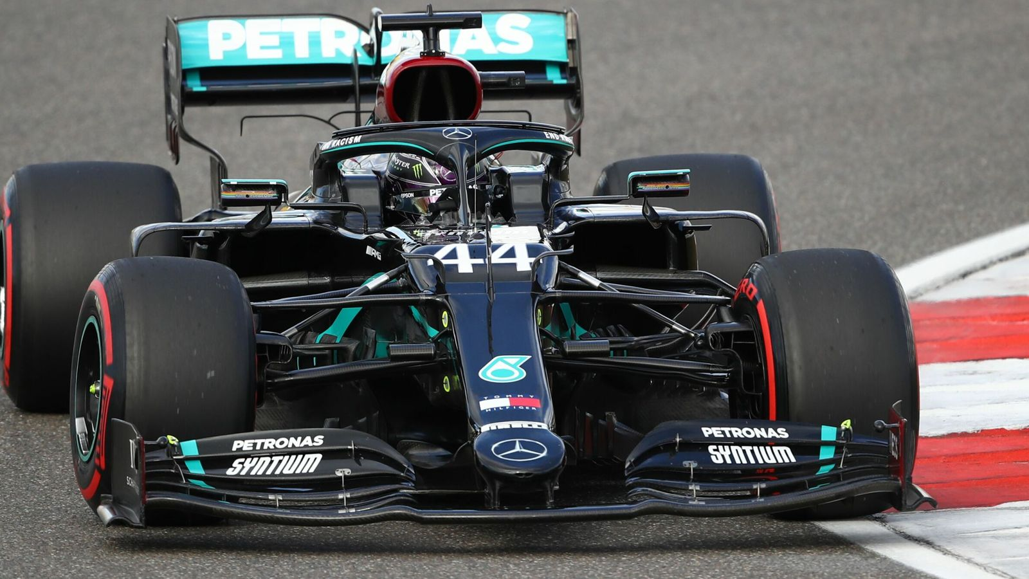
What is elite performance?

Slide 3
What will I learn about?
Unit 1 - Body systems and principles of training
Skeletal system, muscular system, cardio-vascular and respiratory systems,
effects of exercise, components of fitness, principles of training.
Unit 2 - Preparing and planning for health and fitness
Lifestyle factors, diet, health and fitness, fitness testing, PAR-Q, goal setting,
planning a training programme and health and safety.

Slide 4
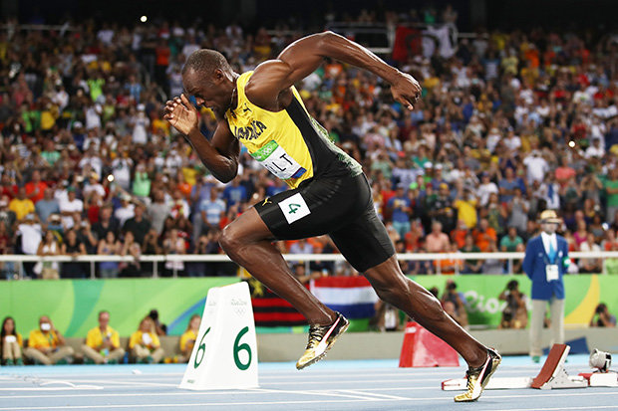
How will I be assessed?
Unit 1 - Body systems and principles of training
1 hour & 30 mins written exam – 40% of total GCSE
Unit 2 - Preparing and planning for health and fitness
21 hours synoptic coursework project– 60% of total GCSE

Slide 5
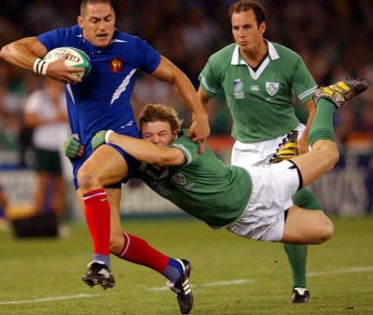
entry requirements & course demands
You enjoy sport/PE lessons – It’s a two year course!
You enjoy biology and are keen to understand how the body and mind works
You are organised and can work well independently
Good work ethic, most lessons are in the classroom
However, there are no requirements to be good at sport because there
are no practical assessments of your own performance

Slide 6
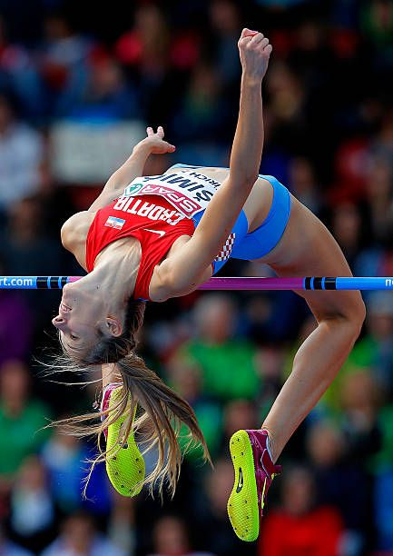
Career pathways
Natural progression is to study A-Level PE or BTEC Sport in 6th Form
Post 16 possible career options include:
- Sports Science - Sports Analysis -
- Sports Business Management - Sports coaching
- Leisure and Tourism employment - Physiotherapy
- Health and Fitness Instructor - PE teacher

Slide 7
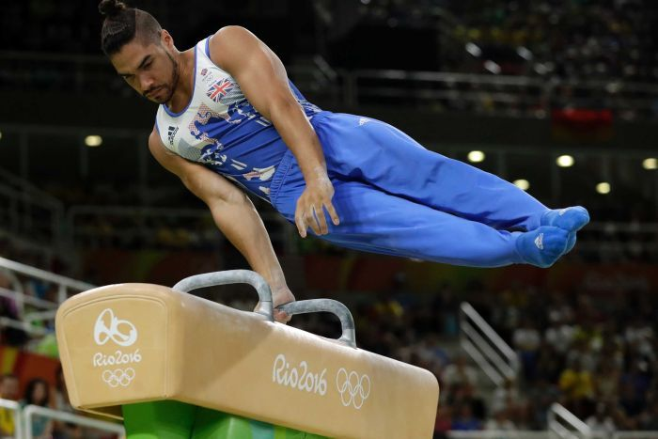
More information
Exam Board : NCFE
Specification: See link below:
NCFE Level 1/2 Technical Award in Health and Fitness (qualhub.co.uk)
More questions: See Mr Kilcoyne or Mr Hamilton

