Slide 1



GCSE History at desborough College

Slide 2
Why TAKE History?
It’s inspiring – providing you with a greater understanding of the world around you whilst helping you to understand other cultures and to answer great historical questions including: “Why are other cultures different from ours?” or “Why are some cultures antagonistic, whereas others are not?” By studying the past, you will learn about what makes people behave the way they do.
It’s useful – Increasing your understanding of diverse societies and their heritage: as a student of history, you will look into how nations were formed by an understanding of a shared past and a common identity. In addition, it enables societies to make progress by learning from the past.
It gives you transferable skills – the world is constantly changing and history provides you with the skills that will help you understand and analyse data and information as well as delivering solutions that will aid you in conquering everyday problems. It is also a multidisciplinary subject that bridges the gap between other subjects including economics, business, psychology and the sciences.

Slide 3
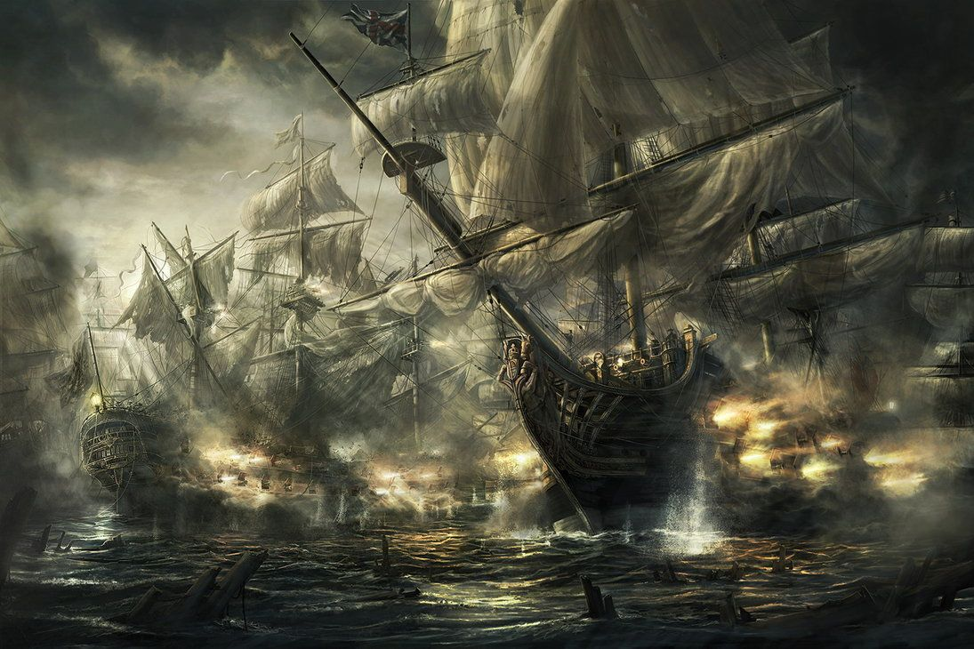

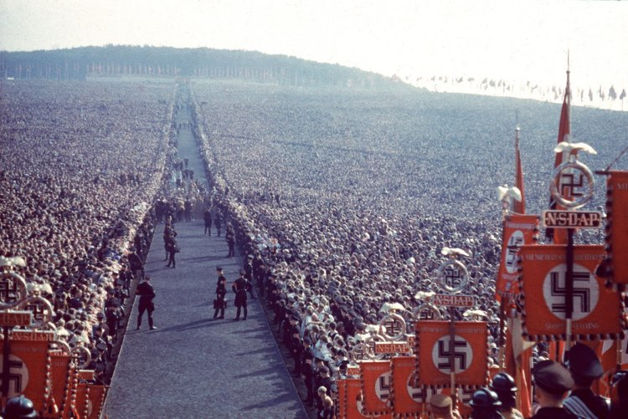
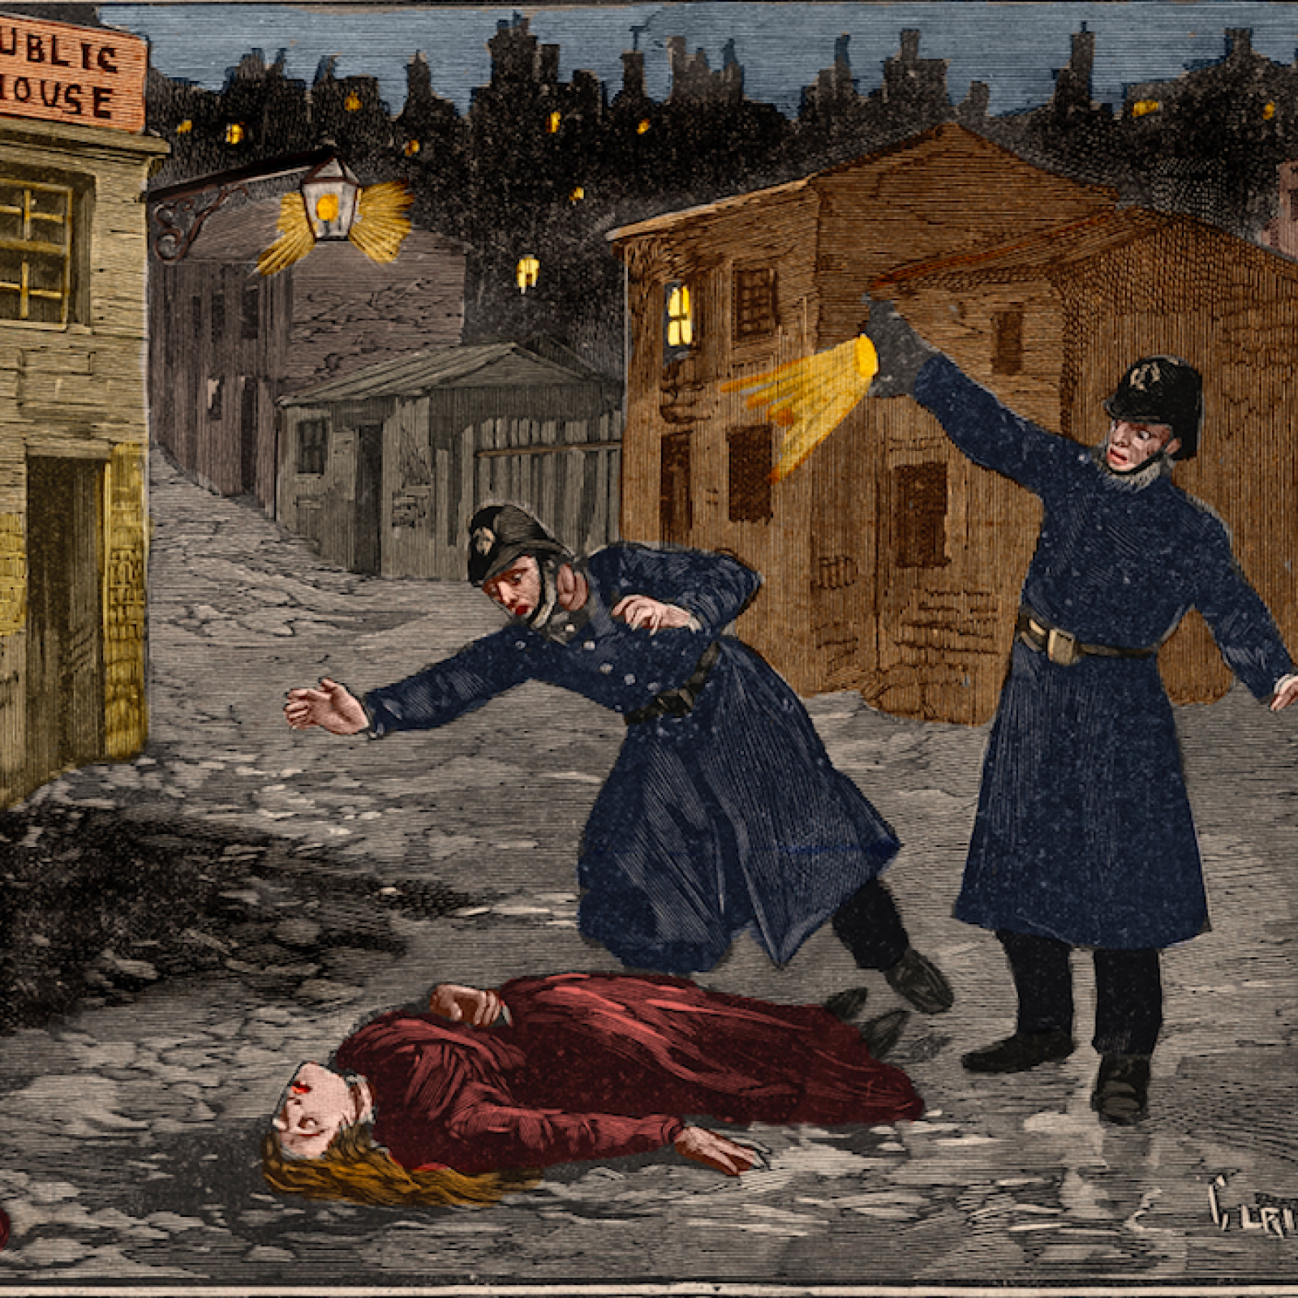
What will we teach?
Elizabethan England
Crime and Punishment
Weimar and Nazi Germany

Slide 4
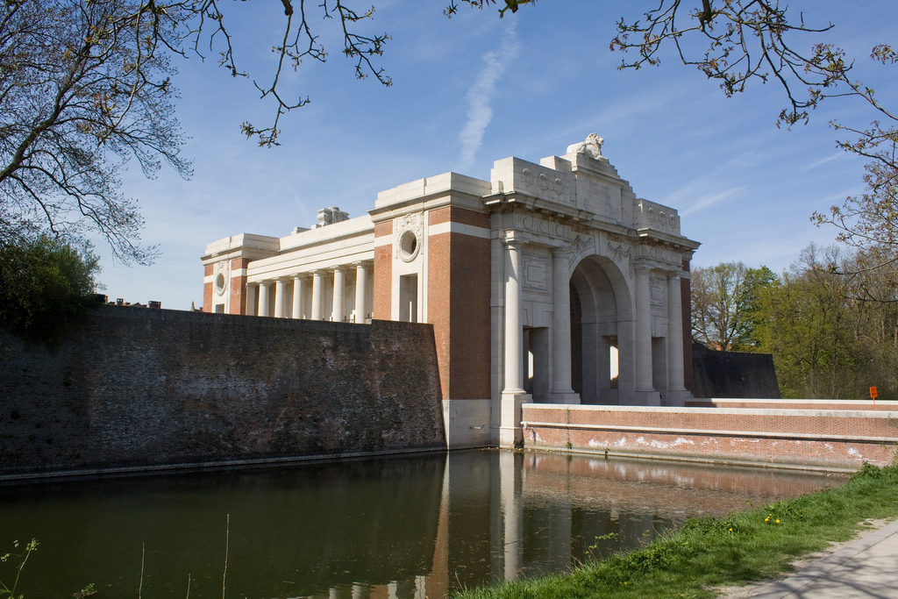
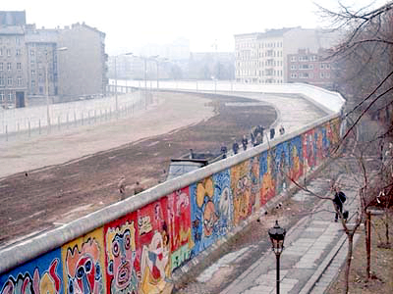
WILL there be any trips?
Berlin – The Berlin Wall was a guarded concrete barrier that physically and ideologically divided Berlin from 1961 to 1989. The Wall cut off West Berlin from surrounding East Germany, including East Berlin.
Belgium - The Menin Gate Memorial to the Missing is a war memorial in Ypres, Belgium, dedicated to the British and Commonwealth soldiers who were killed in the Ypres Salient of World War I and whose graves are unknown.

Slide 5

How is History Assessed?
GCSE History is assessed in three separate exams at the end of Year 11 under the Edexcel exam board:
Crime and Punishment (1 hour 15 minutes)
Cold War and Elizabethan England (1 hour 45 minutes)
Weimar and Nazi Germany (1 hour 20 minutes)

Slide 6
What are the results like?
GCSE History 2018
78% 4-9
GCSE History 2019
61% 4-9
GCSE History 2020
77% 4-9
A level History 2018
100% A*-C
30% A*-B
A level History 2019
65% A*-C
A level History 2020
90% A*-C
30% A*-A

Slide 7
History at Desborough college
The History Department aims to ensure that students develop a passion for, and a critical understanding of, the past.
History is increasing in popularity year on year at Desborough with the majority of Y10 currently studying History and many opting take Geography alongside.
Department staffed by specialists with broad and diverse interests and experience in history:
Mrs Murphy – Modern Political History, USA & Europe. British Imperial History and post colonial societies, the Indian sub-continent and the Middle East
Mr Summers – History of the USA, Transatlantic Cultures and Revolutionary History
Mr Gleeson – Modern European History. Early Modern and Modern Irish History
Mr Collins – Tudor and Maritime History. Travel and Exploration History

Slide 8
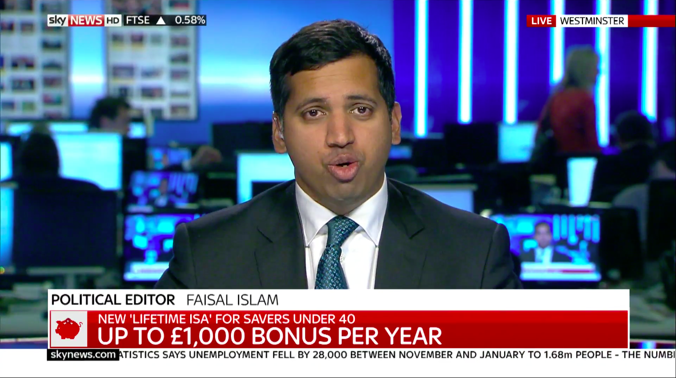
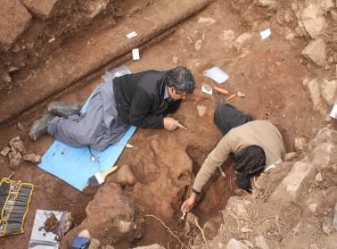
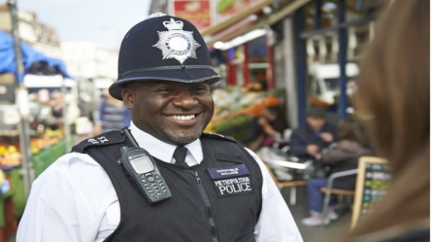

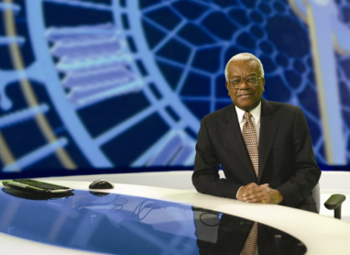
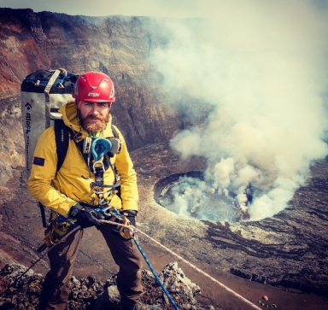
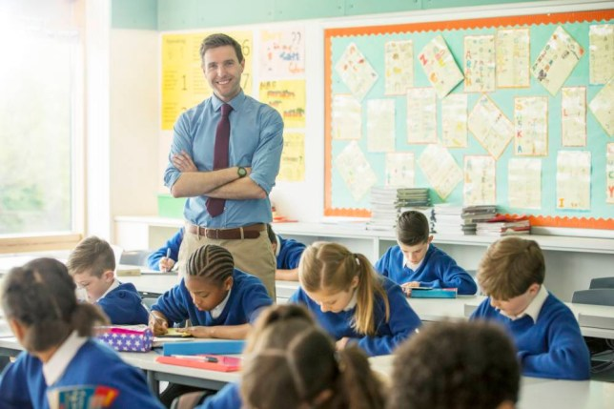
Where could History take you?
Access to University
Apprenticeships
MI5 and MI6
Journalism
University lecturer
Lawyer
CEO
Tech data analyst
Editor
Writer
Tour guide
Museum curator
Civil servant
Politician
Publishing
Documentary film maker

