Slide 1
SPORTS SCIENCE

Slide 2
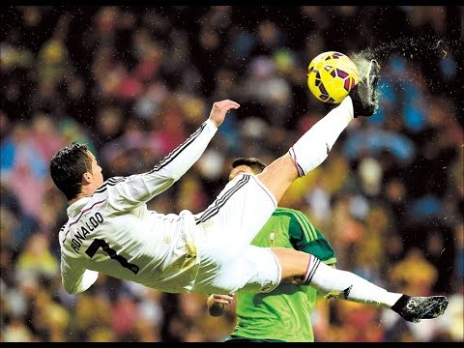
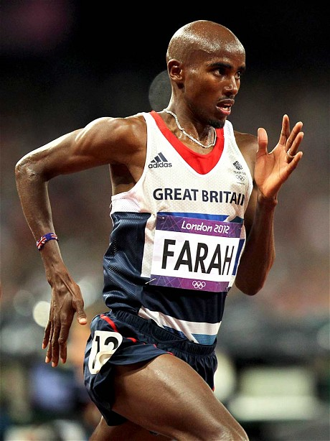
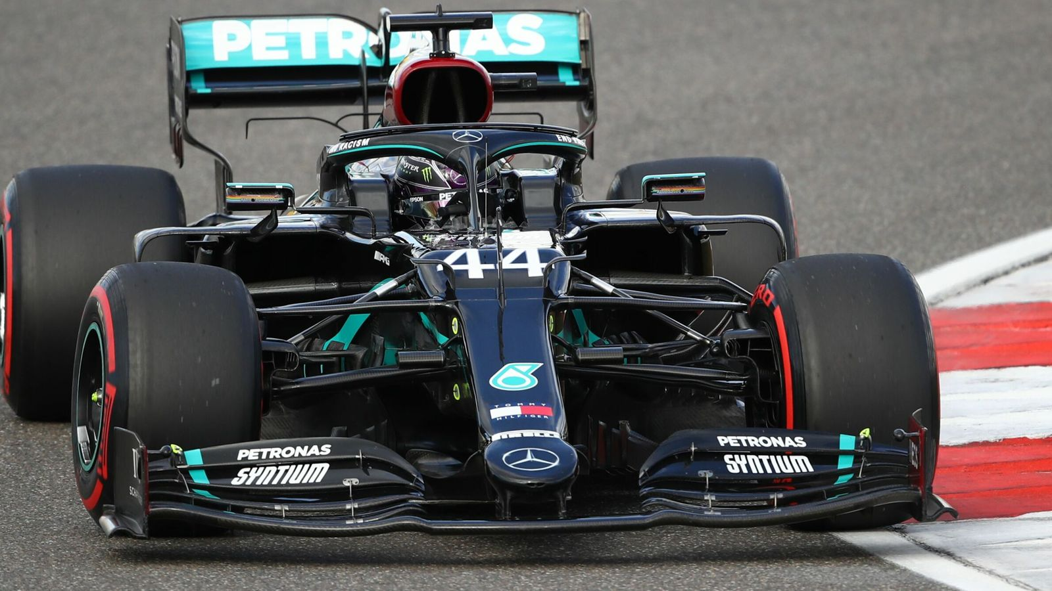
What is elite performance?

Slide 3
What will I learn about?
Unit 1 (Paper 1) - Anatomy & Physiology and Training:
Skeletal system, muscular system, cardio-vascular and respiratory systems,
effects of exercise, levers in sport, components of fitness, principles of training.
Unit 2 (Paper 2) – Socio-Cultural and Sport Psychology:
Participation, commercialization of sport, ethics in sport, feedback, guidance,
drugs in sport, violence, skill, health, fitness and well-being.
Unit 3 – Practical performances and AEP Coursework: (3 sports)
Team Sports – Rugby, Football, Handball, Cricket, Hockey, Basketball
Individual Sports – Athletics, Badminton, Golf, Tennis

Slide 4
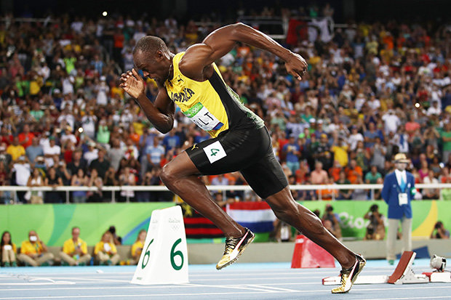
How will I be assessed?
Unit 1 (Paper 1) - Anatomy & Physiology and Training –
1 hour written exam – 30% of total GCSE
Unit 2 (Paper 2) – Socio-Cultural and Sport Psychology–
1 hour written exam – 30% of total GCSE
Unit 3 – Practical performances and AEP Coursework–
3 Sports: 1 team sport, 1 individual sport and 1 other
Controlled Assessment – 40% of total GCSE

Slide 5
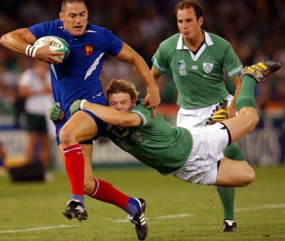
entry requirements & course demands
You enjoy sport/PE lessons – It’s a two year course!
You enjoy biology and are keen to understand how the body and mind works
You are organised – There are four components/exams
You play for a club or school team in at least two sports
(1 team sport & 1 individual sport)
You are willing to work hard in the classroom (80% of lessons are in the classroom!)

Slide 6
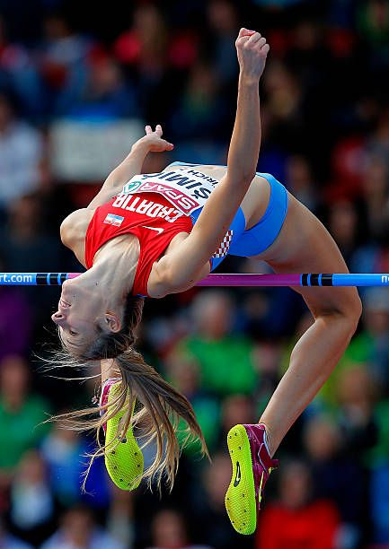
Career pathways
Natural progression is to study A-Level PE or BTEC Sport in 6th Form
Post 16 possible career options include:
- Sports Science - Sports Analysis
- Sports Business Management - Sports coaching
- Leisure and Tourism employment - Physiotherapy
- Health and Fitness Instructor - PE teacher

Slide 7
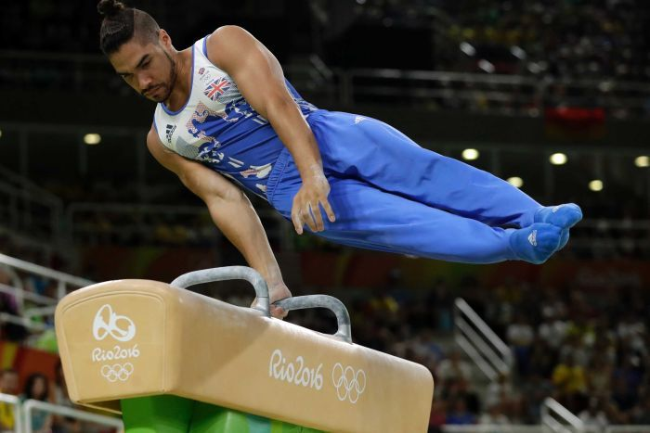
More information
Exam Board : OCR (9-1)
Specification: See link below:
http://www.ocr.org.uk/qualifications/gcse-physical-education-j587-from-2016/
More questions: See Mr Hamilton or Mr Furmage

